Slide 1


Power Theft Detection Using IOT
AY 2021-25
GITAM UNIVERSITY
Capstone Project
Project ID: PROJ2999
A University should be a place of light, of liberty, and of learning.
Department of Electrical Electronics and Communication Engineering
Project Team:
G. Rohith Sai Devanga
S. Bharat Kumar
M. Vamsi Krishna
Project Mentor:
Dr.HJ. Jayatheertha
www.gitamedu.com

Slide 2




Project Group – Details
Photo
Track
Roll No
Name
EECE AI/ML
BU21EECE0100199
G Rohith Sai
EECE AI/ML
BU21EECE0100142
M Vamsi Krishna
EECE AI/ML
BU21EECE0100388
S Bharat Kumar

Slide 3
CONTENTS
Introduction
Abstract
Objective and Goals
Literature Survey
Block diagram of a project
Analysis SWOT
Flow chart of project
Circuit diagram
List of components & specifications
Analysis of Component quality & cost management
Advantages & Disadvantages of project
Conclusion
Future Scope of the project
Reference

Slide 4
Introduction
Electricity theft is a very common problem, especially in our country. As our population is high so the use of electricity is tremendously high. There are many operational losses involve in the generation, transmission, and distribution of electrical energy. Whereas the losses implicated in generation can be technically defined, but transmission and distribution losses cannot be precisely quantified with the sending end information. In T&D the Technical losses are computed with the information about total load and the total energy bill. Electricity theft is a social evil, so it has to be eliminated completely. Power consumption and losses have to be closely monitored so that the generated power is utilized in a most efficient manner. The system prevents the illegal usage of electricity.

Slide 5
ABSTRACT
Science, and technology with its miraculous advancements fascinated human life to an honest extent that will imagine a world without these innovations is hardly possible. While technology is on the raising slope, we should always also note increasing immoral activities. With a technical view, "Power Theft" is also a non-ignorable crime that's highly prevalent, and at the same time, it directly affects the economy of a nation. Detecting and eradicating such crimes with the help of the developing scientific field is that the "Need of the Hour". With these views the was paper conceived and designed. Our paper provides an entire and comprehensive tool to stop power theft which is extremely simple to understand and easy to implement. It includes some sections-transmitting, receiving, and processing sections. The most objective of this project is to point power theft to the electricity board. It's carried over through embedded technology. Here a wireless method is utilized to hunt out electrical theft.

Slide 6
OBJECTIVE AND GOALS
Objective: To develop an efficient and reliable system for detecting power theft, minimizing financial losses for utility companies, and ensuring fair electricity distribution.
Goals:
Identify and monitor irregularities in electricity consumption patterns.
Implement real-time power theft detection using advanced technologies like IoT and machine learning.
Reduce energy losses by accurately pinpointing theft locations.
Improve the accuracy of energy billing for consumers and utilities.
Enhance overall system security to prevent future power theft attempts.

Slide 7
Analysis - SWOT
Strengths
Weaknesses
W1. Expensive
W2. False-Positives.
W3.Maintaince
W4. Expertise
S1. Cost-Saving
S2. Efficient
S3. Real-Time Simulation
S4. Advanced Motion Planning
Opportunities
Threats
T1. Cyber security
T2. Resistance
T3. Legal
O1. Smart-grids
O2.Market-Expansion
O3. Collaboration

Slide 8
LITERATURE SURVEY
Author(s) | Year | Methodology/Technique | Key Findings | Limitations
Smith et al. | 2019 | Machine Learning (ANN) | Accurate detection of abnormal consumption patterns | High computational cost
Johnson & Lee | 2020 | IoT-based Monitoring System | Real-time theft detection | Requires significant infrastructure investment
Kumar et al. | 2021 | Smart Meters with Data Analytics | Improved billing accuracy and theft prevention | Susceptible to cyber attacks
Patel & Singh | 2022 | Hybrid AI (ML + Blockchain) | Enhanced security and transparency in energy systems | Complexity in implementation and maintenance
Zhang et al. | 2023 | Deep Learning Algorithms | High accuracy in predicting theft locations | Limited testing in diverse environments

Slide 9
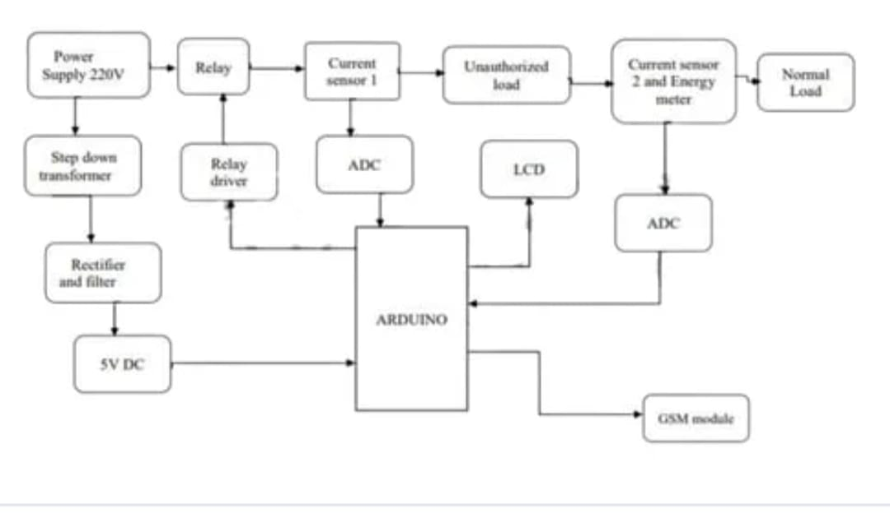
BLOCK DIAGRAM

Slide 10
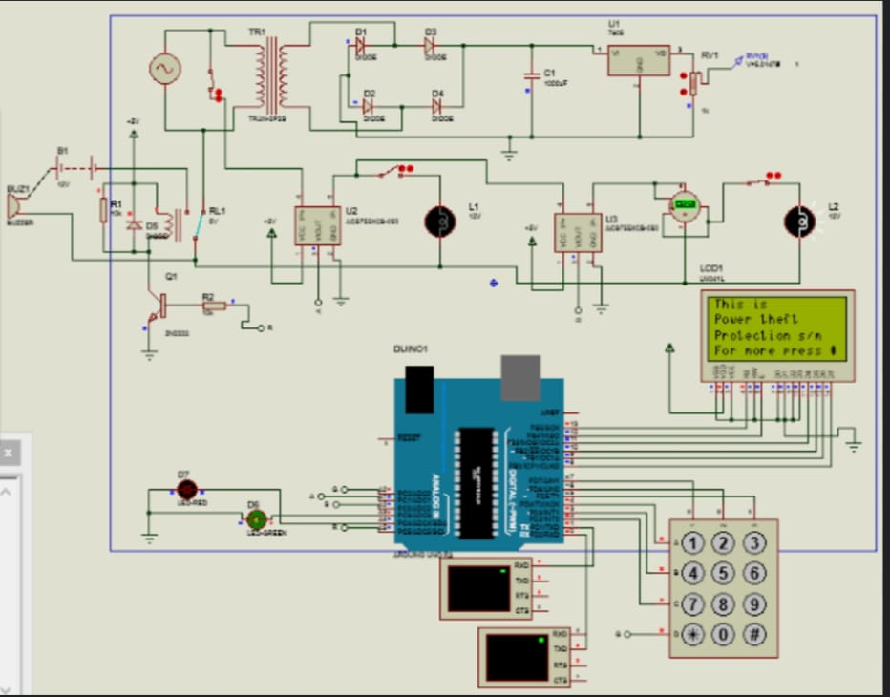
Circuit Diagram

Slide 11
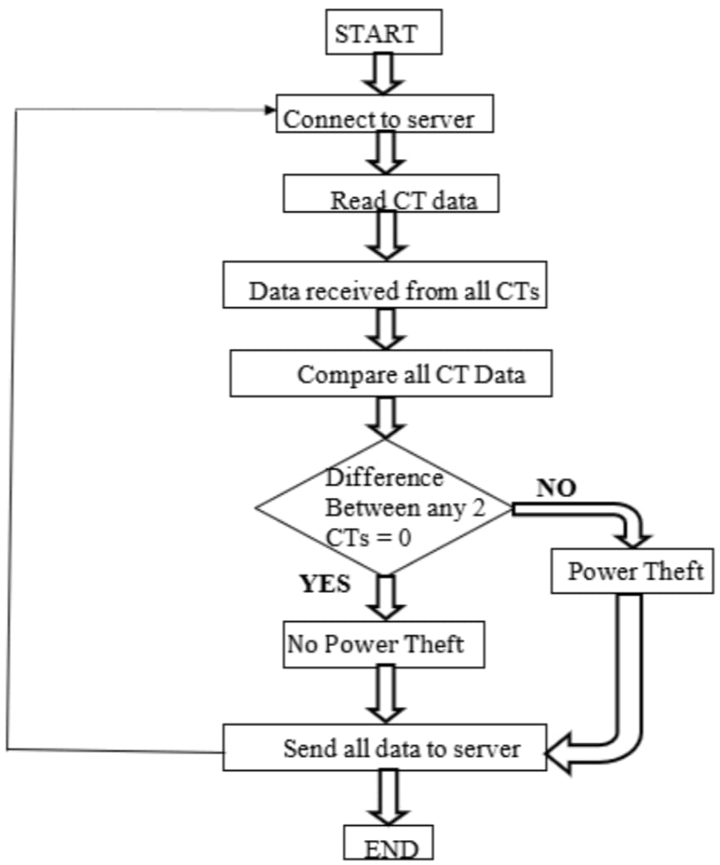
Flow Chart

Slide 12
ADVANTAGES
This System would provide a simple way to detect an electrical
power theft without any human interface wirelessly via Internet.
Maximize the profit margin of power utility company.
Monitor voltage, current and make disconnections and re-connections remotely without employing man power.
The system has Combined advantage for both utility and the customer.
Illegal theft of power via meter tampering can my minimized with the help of this system, thus resulting in high profit margins for the provider.

Slide 13
LIMITATIONS
Since the CT's are connected across each span of distribution system, its installation as well as maintenance cost become higher.
One major disadvantage of this project is that it is not capable of detecting the exact location from where the power is being stolen, giving only approximate location to that place.
Cannot determine who is actually stealing, but even no other existing system is capable of doing this.
If implemented on a large scale, it may take a lot of time and
manual input.

Slide 14
CONCLUSION
In the era of smart city advancement, this project is targeting the connectivity & networking factor of the IOT. during this project, we are detecting the facility theft, identifying the fault and also tracking the location of the fault area to require necessary measures. The proposed system provides the answer for a few of the most problems faced by the prevailing Indian grid system, like wastage of energy, power theft, and cable fault.

Slide 15
FUTURE SCOPE
As mentioned above, we all know that electricity is low and at such time we can't afford power being theft. If this technique is implemented then the sole the quantity of power required is going to be consumed and there'll be no wastage of power.
Moreover even the money spent is often saved. Hence, it'll how of helping within the economic process of the country.
In the present system, IOT energy meter consumption is controlled by Wi-Fi and it helps consumers to avoid wastage use of electricity. The performance of the system can be managed by connecting all household electrical appliances to IOT to consume power.
So, in future following measures can be achieved to save power and avoid thefts.
We can make an IOT system where an owner can monitor energy consumption and can pay the bill online.
We can make a system where an owner can receive SMS when he/she crosses the threshold of electricity usage slab.
We can make a system that can send SMS to the preferred meter reading man of that area when theft detected at the consumer end

Slide 16
REFERENCE
Lanedi C., Dipit. d. Inug, delly inf. Secondaniv. di Npoli, Aversar Italy, Monrela, P.; Inilo G,, "ARM based energy controlling system using smart meter and network server,", IEEE Instrumentation and Measurement Technology conference Binjiang,, pp. 1-6, May-2011.
IoT Based Energy Meter Reading, Theft Detection and connection and Darshan N, Dr. K A Radhakrishnan Rao, " Disconnection using PLC and Power optimization", International Journal of Advanced Research in Electrical, Electronics and Instrumentation Engineering, Vol. 5, Issue 8, 2015
ECI Telecom Ltd., Fighting Electricity Theft with Advanced Metering Infrastructure (March 2011) [Online] Available:
http://www.ecitele.com
M. Golden, B. Min, "Theft and loss of electricity in an Indian State technical report," Int. Growth Centre 2012.

Slide 17

THANK YOU

